Slide 1
Lecture 14: Course Summary
Gregory Gay and Daniel Strüber
TDA 594/DIT 593 - December 15, 2022

Slide 2
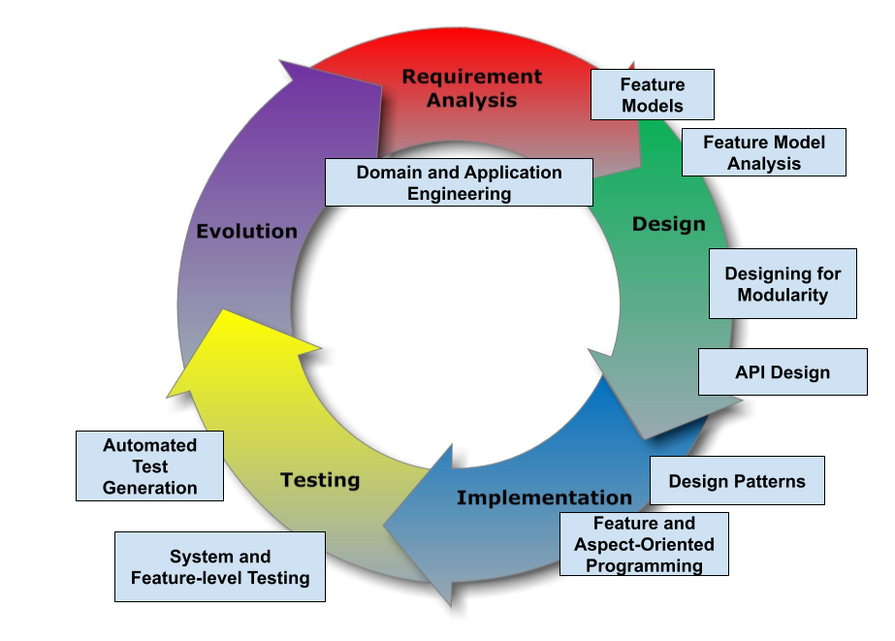
SE Principles for Complex Systems
Notes:
Today is our last lecture, and today, we’re going to use the class to recap what we have covered. The goal of this course was to present advanced techniques aimed at creating complex systems with many interacting features and variable configurations. We examined the design, implementation, and verification of complex systems, focusing on managing complexity at different stages of the development life cycle. We will also examine how the development process must be organized to deliver such systems. Mainly, today, we will be summarizing the key points we covered. This is a great chance to ask questions and get clarification.

Slide 3
Complex???????????
Variability
The ability to change and customize software to deliver variants to new users.
Requires designing code to be reused and to work with reused code.
Changeability and Maintainability
The ability to add new features and options while ensuring that existing code still works.
Notes:
Now, what the $#%#^#$ does complex mean? “complex” can describe about anything. Almost any piece of software you will build, ever, in a professional setting is going to be complex. Anything that is sold commercially. Arguably, every single class you’ve taken here has been prep for building complex systemn. So, we needed to focus in this class in some way. Our focus was, then, on variability and evolution. Variability is the ability to change and customize software, to choose from a set of options to configure and evolve software to the needs of new groups of users users over time, delivering these customized variants to the users that need them. Variability is not a one and done design choice - it is a concious process of designing for evolution. It requires designing and redesigning systems to be reused and to work with the code you are reusing. It requires a constant focus on changeability and maintainability. Our ability to add new options and features to code over time, and our ability to keep the existing code still working in the face of constant change. In this class, that is what we define complex to mean and what we focus on.

Slide 4
Why Change?
The Law of Continuing Change
A program used in a real-world environment must change, or become progressively less useful in that environment.
The Law of Increasing Complexity
As a program evolves, it becomes more complex.
Resources are needed to preserve and simplify structure
Notes:
Software is not a static artifact, not a bridge that we build in place and forget about it until we need to make repairs. The best we can hope for is to build a useful system that will survive long enough for it to be asked to do something new, then try to manage that evolution. In particular, there are two laws of software evolution that come into play and increase development complexity (go over)

Slide 5
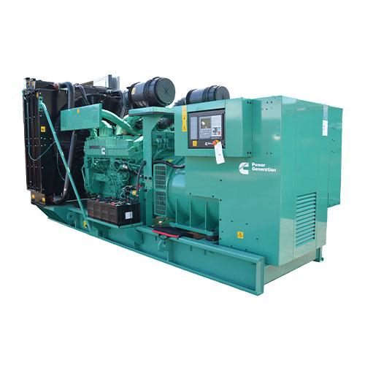
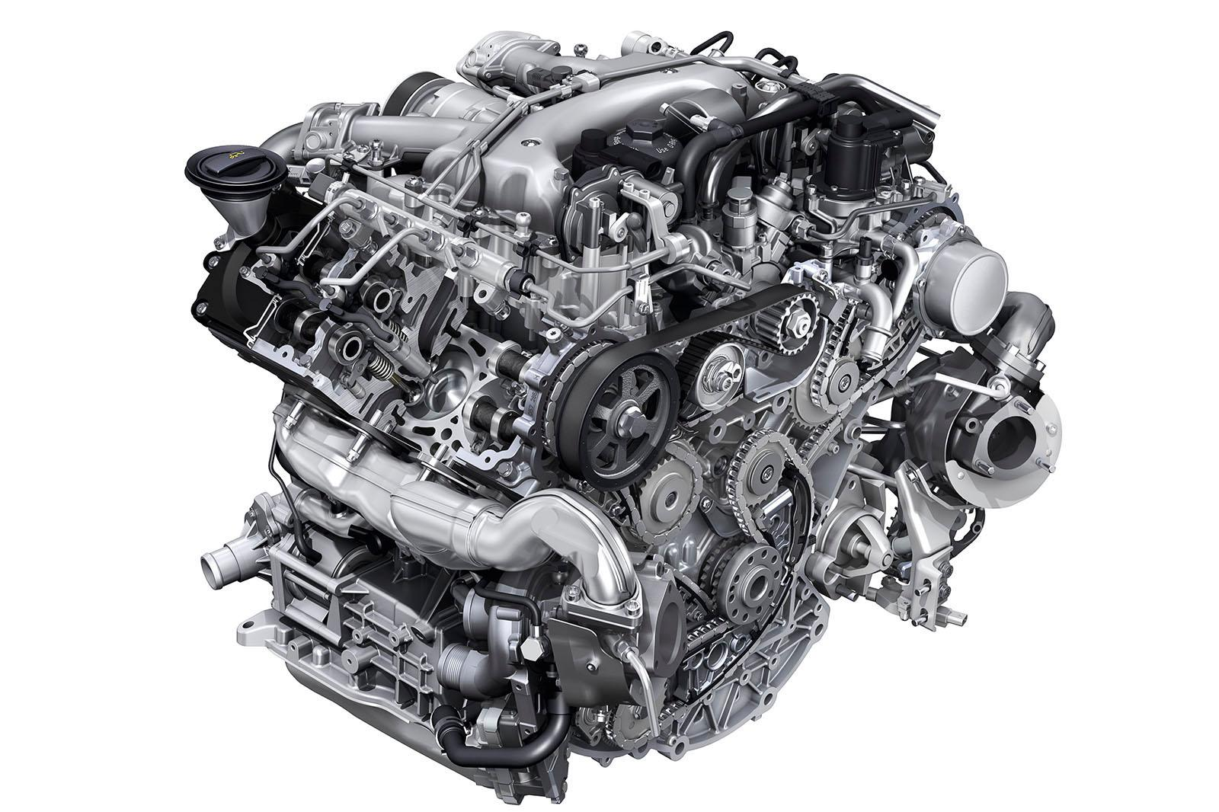
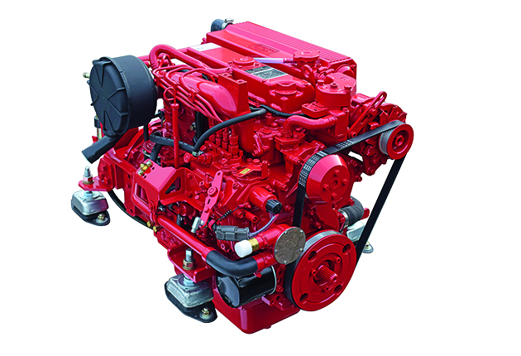
Software Product Lines (SPLs)
Highly configurable families of systems.
Built around common, modularized features.
Common set of core assets.
Allows efficient development, customization.
Core Platform
Notes:
We focused on a particular type of complex system, built around managing change. A SPL is a system designed to yield a set of related software products, developed from a common set of core, reusable assets in a planned way. By developing large software systems in this way, companies can produce a set of products more economically, since the development effort put into the shared assets does not need to be duplicated. SPLs can also help companies to better address product customization tasks to meet specific needs of individual customers. This allows sustaining a high rate of product innovation, while keeping guaranteed levels of overall system performance and quality. SPLs are seen in many domains, and are highly challenging to develop as they have technical, process, organization, and business-related aspects. SPLs are built at Volvo or Boeing, Linux and Android are SPLs, and in many other circumstances. Most systems today are SPLs in some form whether or not the term is used - components are designed for reuse, systems are designed to be highly configurable, and designed to adapt and change over time to meet the needs of evolving markets by easily swapping out elements with standardized interfaces. All of these circumstances require similar design techniques and tactics to enable variation and change over time

Slide 6
Why Software Product Lines?
Designed FOR reuse of assets.
Designed TO reuse assets.
Successful SPLs are highly configurable, and evolve easily over time.
Most modern systems intend to achieve at least one of these two tasks.
SPLs achieve both.
Notes:
SPLs are hugely complex systems that are both designed (1) - we build independent, modularized components that can be selectively integrated. they are also designed (2) - build with a highly evolvable architecture that can easily slot in components. This combination is potent because (3). They are hard to get right, but if you nail it, you NAIL it. Reuse is the name of the game now, regardless of what kind of system you build. The reality of modern software is that most modern systems are designed to achieve at least one of these tasks - they are designed to be reused in some form or to make use of reused assets. If you use a third party code library, you are reusing assets. If you build a standalone, single-purpose system with a REST API, you have designed a system FOR reuse. If you build an Android app that can be launched by another app to respond to a system event, you’ve built a component FOR reuse. Most modern software is designed either to be reused to to reuse assets. SPLs are designed for both. By examining SPLs in detail, we can teach design and verification techniques that apply to a wide range of complex systems, even if they are not SPLs themselves. Design techniques for SPLs are design techniques for any evolvable reuse-driven system.

Slide 7
Domain and Application Engineering
Requirements
Domain Engineering
Design
Requirements
Realization
Design
Core Platform
Testing
Realization
Testing
Application Engineering
Requirements
Design
Realization
Testing
Notes:
In product line development, we are no longer talking about a single piece of software. When we develop a product line, we intend to produce many, many specific pieces of software from a platform of common assets. Instead, we have a two life cycle model, where we perform these activities for the core platform first. This is what we call domain engineering. We plan, design, implement, and test a core architecture and core assets that can be customized and put together in different ways to create many concrete products. Then, for each concrete product, we perform these four activities in a drastically simplified form. We call this application engineering. We create requirements, assemble assets,make any one-off changes we need, and perform product-specific testing to produce each concrete application.

Slide 8
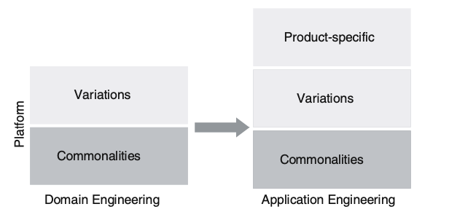
Variability Management
Commonality
Shared between all products.
Implemented in core platform.
Variations
Shared by subset of products.
Implemented in core platform, enabled in subset.
Product-specific
Unique to a single product.
Platform must support unique adaptations.
Notes:
As a result of this structure, variability is a key concept. Instead of understanding each individual system all by itself, product line engineering looks at the product line as a whole and the variation among the individual systems. This variability must be defined,implemented, evolved throughout the entire lifecycle. we distinguish three main types of variability: Commonality: a characteristic common to all products in the product line. This can be requirements, code blocks (methods, to classes, to services and subsystems, any asset. This is then implemented as part of the platform. 2) Variation: a characteristic or asset common to some products, but not to all. It must be implemented in a way that allows having it in selected products only. 3. Product-specific: a characteristic part of only one product – at least for the foreseeable future. While these will not be integrated into the underlying platform, the platform must be able to support them. During the life-cycle of the product line, a specific characteristic may change in type. A product-specific characteristic may become a variability, if it looks like a piece of code we might want to reuse in a different product. A commonality may become a variation as well – for example, if over time the decision is made to support alternatives to that asset (e.g. extending the platform beyond the initial operating system, so some versions now are on iOS while others are on Android - now we have options that we choose form based on the OS). Commonalities and variabilities are handled mostly in domain engineering, when we develop the assets of the platform, and product-specific parts are handled exclusively in application engineering because they are tied to one product.

Slide 9
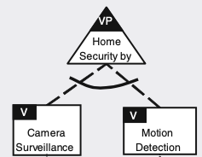
Reasoning about Variability
Variation Point
Where one product can differ from another.
Ex: Which features are supported by this security alarm?
Feature
Options that can be chosen at each variation point.
Ex: Motion detection, camera
Notes:
Variability management covers the whole life-cycle. It starts with the early steps of scoping and requirements, covering all the way to implementation and testing and finally going into maintenance and evolution. variability is relevant to all assets throughout software development. So, it is something we will return to and discuss often. This means that there are some terms to introduce that we can use to reason about variability. Variation point: the variation point describes where differences exist in the final systems (e.g. systems may differ with respect to the operating systems they rely on, with respect to whether they support a particular feature or not, which algorithm a feature uses, etc.) For example, we may have a security alarm product line that can perform different types of detection. Which are supported by a concrete alarm? This is essentially where you make a choice between the different possibilities that exist to satisfy a variation point , what we call features or sometimes variants.

Slide 10
Feature Diagrams
Notes:
One of our core tools in reasoning about variability are feature models.

Slide 11
Feature Modeling
A specification of variation points and features in a hierarchical form.
Represented visually using feature diagrams.
Also represented as propositional logic for analysis.
Enables understanding of dependencies and what valid products can be built using a platform.
Notes:
A feature model documents a product line’s variability. It specifies the set of valid products that we can create, based on the constraints between features at a single variation point or across multiple variation points, specified in a hierarchical manner. Feature models take two forms. First is a graphical form, called a feature diagram, where we create an expanding hierarchy of variation points and the features to fill them, expressed along with additional constraints between these features. This allows us to quickly understand how our common platform can create a variety of real products, and to quickly understand what products represent a valid configuration of the feature model. Besides introducing the graphical language of feature diagrams, we also connect the graphical representation to a formal representation that is the basis of engineering tools that can quickly be used to answer questions about our planned product line - are particular configuraton is valid, are there constraints that are specified incorrectly, what code connects to particular features, and so on.

Slide 12
Feature Diagrams
Mandatory Feature
VisualAppearance ⇔ WebsiteConfiguration
Website Configuration
Content Personalization
Visual Appearance
Optional Feature
ContentPersonalization ⇒ WebsiteConfiguration
Layouts
Dark Mode
Mobile
Tablet
Desktop
Notes:
To review feature diagrams, here we have a partial diagram for a platform for customizing websites. For example, it might present different layouts on a desktop, mobile phone, and a tablet. (click) Some features can be marked as mandatory, with a filled circle. These must be included if their parent feature is included. There can also be represented in a formal logic as a double implication (point out). (click) Some features are optional, and can selectively be included. In propositional logic, these have a single implication. If you choose these features, you must also take their parent.

Slide 13
Example - Website Configuration
Website Configuration
Content Personalization
Or: Choose at least one
((Essential ∨ None ∨ All) ⇔ Cookies)
Advertising
Alternative: Choose only one
((Standard ∨ None ∨ Targeted) ⇔ Advertising) ∧ ￢(Standard ∧ None) ∧ ￢(Standard ∧ Targeted) ∧ ￢(Targeted ∧ None)
Cookies
Essential
None
All
Standard
None
Targeted
Notes:
(click) We also have OR structures - closed fan - where if we select a parent, we MUST select at least one of its child features. Here, we can offer multiple cookie settings, none, all, or only essential. When the site loads, the user can select from the subset that you enable. (click) Then, we have ALternative or XOR structures with a open fan. If we select the parent, we MUST select one and only one child feature.

Slide 14
Implementation
Notes:
Just start with a question - want you to start thinking about this. (read)
This isn’t something with one answer, or even a right answer. It’s something we’ll keep returning to

Slide 15

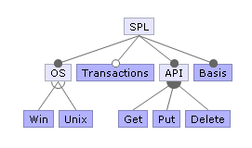
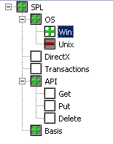

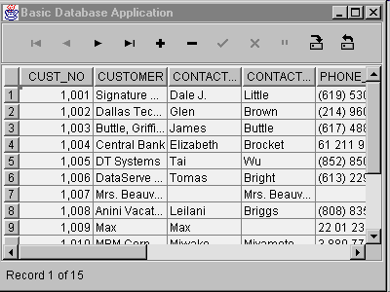
How to implement variability?
Feature model
Reusable implementation artifacts
Domain Eng.
Application Eng.
Feature selection
Generator
Final program

Slide 16
Annotation-Based Representation
Code in common code base.
Code related to a feature is marked.
Preprocessor annotations, if-statements.
Code belonging to deselected features:
ignored (load-time, run-time)
removed (compile-time).
Notes:
A major goal of product line engineering is to derive a product automatically from variable code, based on a user’s feature selection. So, product derivation involves product generation, statically or dynamically. There are two main ways to represent variability and variation points, and how products can be generated: annotation-based and composition-based approaches. We have talked about examples of both, of course. As a reminder, in annotation-based approaches, the code of all features is merged in a single code base, and annotations mark which code belongs to which feature. Preprocessors are our major example of this approach. Depending on the implementation technique selected, During product derivation, all code that belongs to deselected features or invalid feature combinations is removed (at compile time) or ignored (at run time) to form the final product.

Slide 17
Composition-based Representation
Feature code in dedicated location.
Class, file, package, service
Selected units combined to form product.
Requires clear mapping between features and units
Notes:
On the other hand, composition-based approaches locate code belonging to a feature or feature com- bination in a unit of some kind - a dedicated file, pacakge, class, service, or module. During product deriva- tion, all units of all selected features and valid feature combinations are com- posed to form the final product. A classic example is a framework that can be extended with plug-ins, ideally one plug-in per feature; different products can be generated by integrating different plug-ins. The key challenge of composition-based approaches is to keep the mapping between features (problem space) and composition units (solution space) simple, ideally one-to-one. If each feature has its own imple- mentation in the form of a composition unit, a generator can simply include the corresponding unit in the composition when a feature is selected.

Slide 18
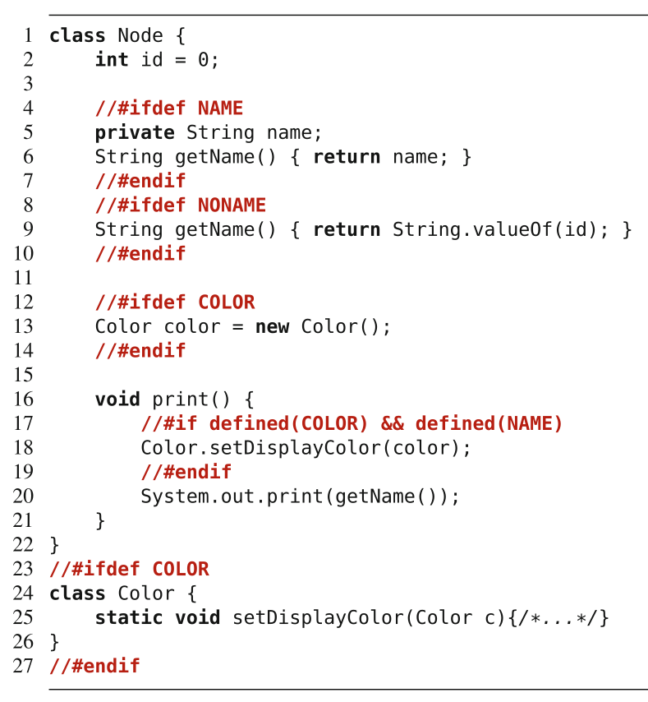
Variability with Preprocessors
Selectively include or exclude code before compilation
Developer wraps conditional code with preprocessor directives
Preprocessor removes deselected code before compilation
Exist for many languages, most famous: cpp (for C, C++)
Notes:
A preprocessor is a tool that manipulates source code before compilation, with the intent of optimizing the final executable in some form - whether for speed or, in our case, to configure that executable for a particular use. A popular preprocessor is the C preprocessor cpp, which is used in almost every C and C++ project. Most of the examples we’ve seen of this are using cpp so far. cpp provides directives to inline files, to define macros, and to remove code frag- ments based on user-defined conditions. In addition to cpp, many other preprocessors exist, we will talk about Antenna in Java. Important in product line or variable systems development, preprocessors typically provide facilities for conditional compilation, where marked code fragments in the source code are conditionally removed before compilation— #ifdef and #endif in cpp (go over example a little). Conditional compilation is probably the most common mechanism for implementing variability in product lines in industrial practice. This is the prototypical example of tool-based, compile-time, annotation-based variability implementation.

Slide 19
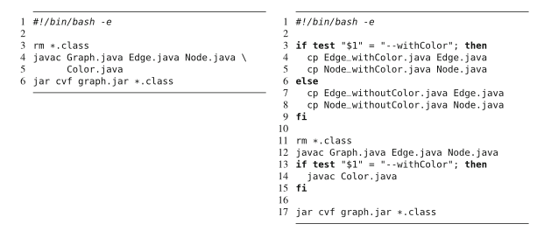
Variability with Build Scripts
Compiles code conditionally depending on features selected.
Feature selection read from file or inferred from environment (language, location, software).
Features can control how files compiled.
Notes:
Shell scripts are typical means to automate tasks. As such, they can also be used to automate builds. A simple build script in shown on the left: The script first removes all old class files, compiles all Java file, and finally packages all resulting class files in a JAR file for distribution. Now, let’s introduce variability into this build script. On the right, we check whether the parameter withColor is provided, and we compile one of two implementations of the classes Node and Edge, one with and one without colors. Further, we compile class Color conditionally. In this example, we use the parameter approach (which we will talk a little more about soon) and apply it at build-system level. Depending on the parameters, different files are compiled and packaged. Instead of passing configuration options to the build script as command-line parameters, build systems can read configuration options also from configuration files (potentially generated by a feature-selection tool). Additionally, build systems can determine configuration options automatically by inspecting the current context; for example, they can read the operating system’s language or location settings or detect whether certain hardware features or software libraries are available. When building against external libraries, variability in a build script can control which libraries (and which library revision and variant) the product is compiled with. Finally, features can control how files are compiled, including triggering optimizations, using certain compilation options, or including debugging information.

Slide 20
Variability with Parameters
Use conditional statements to alter control flow based on features selected.
Boolean variable based on feature, set globally or passed directly to methods:
From command line or config file (load-time binding)
From GUI or API (run-time binding)
Hard-coded in program (compile-time binding)
Notes:
We can start to talk about implementing variability in the code with the simplest method, and work our way up to more complex methods. A simple way to implement variability is to use conditional statements (such as if and switch) to alter the control flow of a program at run time based on the selections made for each variation point. In our context, conditional statements are typically controlled by configuration parameters passed to a method or a module, or set as global variables in a system. Different parameter assignments lead to different verisons - different configurations of a program when it is executed. There are many ways to set configuration parameters. In general, we expect one Boolean parameter per feature, either set globally or at an appropriate level of scoping. These variables should, ideally, be named in a way that directly maps to the feature model. Often, command-line para- meters (such as in “ssh -v”) or configuration files (such as system.ini or httpd.conf) are read at startup and stored in global variables. This is an example of load-time binding - we make choices when the program is executed, by passing in our choices from the command-line or using this configuration files. In other cases, users can change parameters in a GUI using preference dialog boxes or as part of an API request - such as a POST request to a REST api, sometimes with immediate effects - run-time binding - or at other times requiring a restart - load-time. In a third, rarer case, values of variables can also be hard-wired in source code, so changing them requires recompilation - AKA a compile-time binding. So, the use of parameters is a flexible approach, simply noting in the code how to make use of these parameter settings.

Slide 21
Design Patterns
Notes:
Just start with a question - want you to start thinking about this. (read)
This isn’t something with one answer, or even a right answer. It’s something we’ll keep returning to

Slide 22
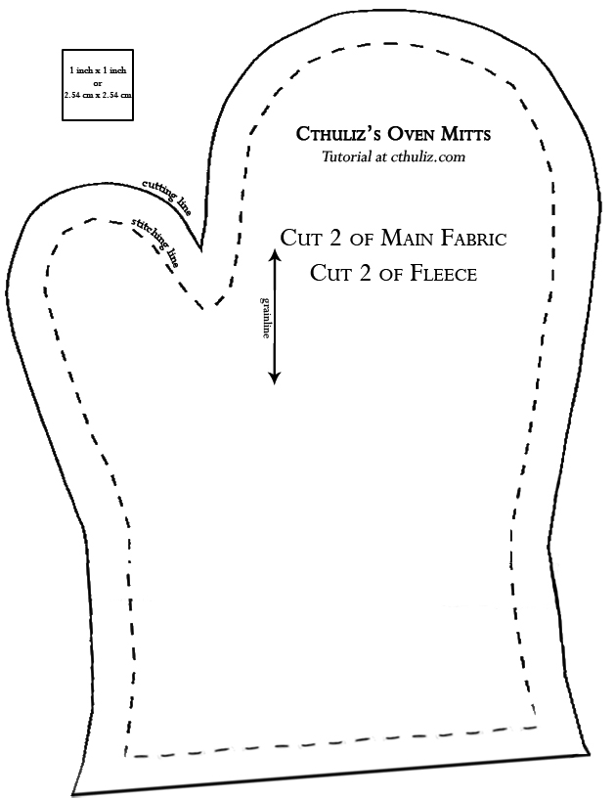
Design Patterns
Don’t just describe classes, describe problems.
Patterns prescribe design
guidelines for common
problem types.
Notes:
Design patterns serve as a reference guide for design - for particular types of systems or development situations, they offer design guidelines for how to structure a set of classes to work together for a particular purpose. We discussed six design patterns particularly relevant for systems that will evolve or that have a high level of customizability, like product lines.

Slide 23
Principles of Design
Identify aspects that vary and encapsulate them away from what doesn’t.
Program to interface rather than implementation.
Favor composition over inheritance.
Open for extension, but closed for modification.
Talk only to your immediate friends.
Notes:
these patterns capture several design principles that allow evolution and variability without increasing complexity. (read)

Slide 24
Strategy Pattern
Defines family of algorithms, encapsulates them, makes them interchangeable.
Robot
MoveBehavior myMove
ShootBehavior myShoot
target()
shoot()
move()
display()
setMoveBehavior()
setShootBehavior()
<<interface>>
MoveBehavior
move()
MoveWithWings
move() { .. }
MoveWithWheels
move() { .. }
<<interface>>
ShootBehavior
shoot()
TankRobot
display() { .. }
DogRobot
display() { .. }
DroneRobot
display() { .. }
GunShooting
shoot() { .. }
LaserShooting
shoot() { .. }
Notes:
The Strategy Pattern, in particular embodies many of these lessons. This is a pattern where algorithms describe behaviors. You take those, implement them, and make them interchangable by ensuring they all offer the same interface. For example, here we have robots. We have a parent Robot class that implements a set of methods, then child classes that represent concrete robots that we can instantiate. The robots all target in the same way, but can move or shoot in different ways. Some robots move or shoot in the same way, but there are multiple options for how they do this. So, we implement each concrete way a robot can move or shoot in its own class. Each of those implements the same interface, so we can call it in an identical way. As a result, these behaviors are interchangeable at runtime and the code can work with any form of that behavior, as they are called in the same way. You can add in new assets - new behaviors - to that set over time and make use of them by binding the appropriate class at runtime. Or if we need, we can change these assets.

Slide 25
Identify aspects that vary and encapsulate them away from what doesn’t
Behaviors shared by some children (variations) implemented as classes sharing a common interface.
Robot
MoveBehavior myMove
ShootBehavior myShoot
target()
shoot()
move()
display()
setMoveBehavior()
setShootBehavior()
<<interface>>
MoveBehavior
move()
Implement common behavior in parent. Children implement unique (single product) behaviors.
MoveWithWings
move() { .. }
MoveWithWheels
move() { .. }
<<interface>>
ShootBehavior
shoot()
TankRobot
display() { .. }
DogRobot
display() { .. }
DroneRobot
display() { .. }
GunShooting
shoot() { .. }
LaserShooting
shoot() { .. }
Notes:
The first lesson (title). This allows us to evolve the aspects that vary while protecting the rest of the program that is done and unlikely to change. This way, changes do not spill over and introduce bugs in that code, and that code can remain untouched for the most part. This makes it easier to evolve the system, identify problems when there are failures, and fix bugs without introducing new bugs. In this pattern, we separate variable code from static code in two ways. (click) First, we use inheritance. We implement some methods in the parent code that are shared by all concrete children. The shared methods are static and will not be changed, these are commonalities shared by all robots, then in each child we implement the truly unique behaviors - the single product characteristics. In this case, the display method will have a specific implementation for each robot, and no other robot will have the same display code. That can be localized to that child. (click) Then, we implemented the behaviors shared by some children as their own classes sharing a common, swappable interface. More than one child can use this code now, but the code is written in a single class instead of having to appear in every child with that behavior. If the code needs to change, we can change it in one place. It becomes a reusable asset.

Slide 26
Program to interface rather than implementation
<<interface>>
MoveBehavior
move()
Robot d = new DroneRobot();
d.move();
Behavior called in same way for all robots. Only need to implement behavior once.
MoveWithWings
move() { .. }
MoveWithWheels
move() { .. }
Robot
MoveBehavior myMove
ShootBehavior myShoot
target()
move()
shoot()
display()
move() {
myMove.move();
}
Notes:
Program to an interface, not an implementation. Even if the result varies, we always offer the same way to access the appropriate version of the same type of behavior. Offer that assurance that no matter what type of robot we have, we can call move() or shoot() and get the right result.In the robot, we state that there will be a moveBehavior and a shootBehavior. All children inherit those attributes, but in those children, we can assign the appropriate instance of Moving or Shooting. However, we can access the right behavior in the same way without needing to know which robot it is or which version of moving it is. We will get the right result.

Slide 27
Favor composition over inheritance
A class can be composed of building blocks of encapsulated variable code. Class calls into the block.
Robot
MoveBehavior myMove
ShootBehavior myShoot
target()
shoot()
move()
display()
setMoveBehavior()
setShootBehavior()
<<interface>>
MoveBehavior
move()
MoveWithWings
move() { .. }
MoveWithWheels
move() { .. }
<<interface>>
ShootBehavior
shoot()
move() {
myMove.move();
}
GunShooting
shoot() { .. }
LaserShooting
shoot() { .. }
Notes:
This leads to another principle of OO programming. Inheritance is useful, but not always the answer. Often, we should favor composition over inheritance. A robot has a moving behavior, it has a shooting behavior. But, instead of inheriting behavior from parent classes and making overrides, we have implemented the behaviors once and composd new versions of a class from the right building blocks. We restrict a robot to what is true of all robots, then build a new robot from the right set of behaviors. This is the principle of composition - building a class from small independent blocks - something we have repeated over an over when talking about product lines. Inheritance can be great, but only for those things that are shared between a parent and all children. Composition is better for those aspects that vary and can change over time. We cna change the behavior of a class without changing the code of the class.

Slide 28
The Decorator Pattern
Each Decorator offers same methods the Component offers.
Component
behavior()
// Other methods
Decorators add new behaviors to Components
ConcreteComponent
behavior()
// Other methods
Decorator
behavior()
// Other methods
Each concrete Decorator has instance variable to store wrapped component.
ConcreteDecoratorA
Component wrapped
behavior()
newBehavior()
// Other methods
ConcreteDecoratorB
Component wrapped
Object newAttribute
behavior()
// Other methods
Decorators add behavior by adding operations and attributes.
Notes:
The idea of favoring composition over inheritance also takes center stage in the decorator pattern. Here we have two concepts - Components, what gets decorated - and Decorators, what wraps around a component. We deal with two levels of inheritance. (click1) We create a base Component that all concrete components inherit from. Then we dynamically add new behavior to components by wrapping them in a decorator. (click2) Then, we have a base Decorator that defines what all Decorators must offer. Since it inherits from Component, all Decorators will offer the methods that all Components offer, in addition to anything they add. (click3) Decorators contain an instance variable to store the object being decorated. That’s how we keep track of what is being wrapped. We can infinitely keep wrapping, we just maintain a pointer to the next layer down until we reach the center. (click4) Decorators can also add new behavior by adding additional attributes and operations. That said, new behavior is typically added by doing computation before or after calling an existing method in the component.

Slide 29
Ordering System - Decorator Pattern
Beverage
description
getDescription()
cost()
CondimentDecorator
Milk
Beverage beverage
cost()
Mocha
Beverage beverage
cost()
Decaf
cost()
DarkRoast
cost()
Espresso
cost()
HouseBlend
cost()
Soy
Beverage beverage
cost()
double cost(){
double total = beverage.cost();
total+=10;
return total;
}
Notes:
An example of this is a coffee ordering system. We have coffees that we serve, then we have toppings. Toppings cost money on top of the base coffee price, and you can add many toppings. To get the right price for the final drink, we can wrap the concrete beverage in one or more decorators. Each decorator has a pointer to what it decorates. To get the final cost, it calls to the cost method of its decorated object. IT then adds to that total and returns the final cost. This all works by having two levels of inheritance from a core Beverage, so all objects, no matter how many decorators, share the beverage datatype.

Slide 30
The Open-Closed Principle
Classes should be open for extension, closed for modification.
Add new behavior without changing existing code.
Create class with new data and operators, attach class it is intended to extend.
Allow extension without direct modification.
Do not try to apply this everywhere.
Focus on areas likely to change.
Notes:
This introduces another fundamental principle of OO design - (1). New features are great. We will eventually need them, so add away. But, we spent a lot of time testing and debugging the existing code, so don’t modify that. If it isn’t broken, don’t change that. Change will happen, but we can allow that to occur without directly modifying what we already have. Instead, take that unchanging class, attach it to a new class that builds in new data and operations. That new class can make use of anything in the class that it is holding, that it is attached to, and can add new features on top of that. Now, this is not something you want to apply everywhere. Following this principle means adding new levels of abstraction to the system, adding complexity to the code. Focus on the areas that are likely to change in the system and apply this principle there.

Slide 31
The Facade Pattern
Create a new class that exposes simple methods (the facade).
Facade calls on classes to implement high-level methods.
Client calls facade instead of classes.
Classes still accessible.
HomeTheater
Facade
startMovie()
endMovie()
startSpotify()
endSportify()
startRadio()
endRadio()
Amplifier
BluRayPlayer
Tuner
Stereo
Lights
Projector
Screen
PopcornMaker
Notes:
The facade pattern is used to define a simplified interface that can be used to interact with a set of highly coupled classes. Those classes remain accessible, but interaction with them can be simplified in a class that captures some common use cases for interacting with those classes. Here, we have a Facade that lets you start or end a movie. This means your code does not have to perform a set of detailed interactions to accomplish this task. Client code calls methods on the facade instead of the individual subsystem classes, so it acts as an interface. Facade still leaves the individual classes accessible to use directly. If you need the advanced functionality, it’s still there and ready to be used, but the rest of the time, it simpifies our code and decouples the subsystem from the client code, easing change - if change occurs, we can change the facade instead of client code calling into the individual classes.

Slide 32
The Principle of Least Knowledge
Talk only to your immediate friends.
Be careful of the number of classes your class interacts with and how it interacts with them.
Only invoke methods that belong to the object, objects passed as parameters, objects created or instantiated, and attached objects.
Notes:
That is the principle of least knowledge - talk only to your immediate friends. Reduce the number of interactions between objects whenever possible. When designing a class, be careful of the number of classes it interacts with and how it comes to interact with them. This prevents us from creating designs that are highly coupled together. When you have a lot of dependencies, you’re building a fragile system that will be expensive to maintain and complex for others to understand. We Only invoke methods that belong to the object itself, objects passed in as parameters, objects the method creates or instantiates, and components of the object. The Facade Pattern maintains this idea by ensuring that the client only has one friend, the Facade. One friend is a good thing. The Facade keeps the client simple and flexible by managing the subsystem components for the client - it adds in this simple interface layer, and we only need to worry about understanding what that interface offers. We can upgrade the home theater -change how blu-rays are played - without upgrading the code in the client that does things with that theater, like watching the blu-rayss.

Slide 33
Let’s Take a Break
Notes:
Just start with a question - want you to start thinking about this. (read)
This isn’t something with one answer, or even a right answer. It’s something we’ll keep returning to

Slide 34
Modular implementation: components and services
Notes:
Just start with a question - want you to start thinking about this. (read)
This isn’t something with one answer, or even a right answer. It’s something we’ll keep returning to

Slide 35
Frameworks
A collection of classes that represent solutions to related problems.
Base implementation that can be extended with plug-ins, supporting new custom use cases.
Provides extension points (“hot spots”)
Framework is responsible for main control flow, asks plug-ins for custom behavior.
Notes:
A framework is an incomplete set of collaborating classes that represent some kind of abstract idea and a set of solutions for a family of related problems, and that can be extended and tailored for a specific use case. It represents a reusable base implementation for a related set of problems, and thus perfectly fits the needs of product-line development, and supports reuse at a larger granularity than classes. A framework provides explicit points for extensions, called hot spots or hooks, at which developers can extend the framework. Often, extensions are called plug-ins. In the same manner as the strategy design pattern, a framework is responsible for the main control flow and asks its extensions for custom behavior, on demand.

Slide 36
Variability with frameworks
Composition-based, load-time.
White Box: Subclass an abstract parent, override template methods to implement features.
Black Box: Register plug-in objects that provide specific features.
Provides clear modularity, but requires extensive up-front design effort.
Notes:
go over
annotation (mark notes in the code to denote feature boundaries), compositon (feature code is separate and plugged in from a the correct class.

Slide 37
Components
A component is a standalone unit with specified interfaces and explicit dependencies.
Can be deployed independently.
Can be reused in many systems.
Can vary from one class to many.
Developers can choose to implement their own components or work with existing ones.
Requires compatible interfaces and data.
Notes:
A component is a unit of composition with specified interfaces and explicit context dependencies only. Basically, a component stands alone, and only interacts with other parts of the same system through its interfaces. A component can be deployed independently and can be used by third parties in different systems. The key idea of a component is to form a modular, reusable unit. A component provides its functionality through an interface, whereas its internal implementation is encapsulated and hidden. A single class can be seen as a small component that can be reused in many applications, but a component can also encapsulate many classes. You might use the oauth library to handle username and password authentication. That is a component, interacted with through its interfaces, that is used in many many web applications, that internally contains a number of classes. A key idea here is that components can stand alone from the broader systems they are used in. Developers can implement and deploy components independently, and select components from different sources. As a consequence, developers can decide whether to implement their own components or whether to find and reuse third-party components. This can be great - it can sharply reduce development effort, and can enable code reuse from project to project. the challenge here is that components are compatible only if they and their interfaces are designed to existing standards. Reusing components is often hard, because their architectural assumptions may not match the requirements of your project. If so, components require engineering effort to use, and require awkward interface matching ,or adaptation of returned results.

Slide 38
Variability with components
For features that offer standalone functionality with explicit interface and dependencies.
Interfaces often standardized (REST), leading to services.
Can be reused in many projects.
Integrated as part of a broader architectural design.

Slide 39
Feature- and Aspect-Oriented Programming
Notes:
Just start with a question - want you to start thinking about this. (read)
This isn’t something with one answer, or even a right answer. It’s something we’ll keep returning to

Slide 40
Feature orientation
Language-based approach for feature traceability
Implement each feature in a feature module
Perfect feature traceability
Feature modularity
Feature-based program generation
Programs generated via feature composition

Slide 41

Aspect orientation
Modularize a cross-cutting concern into an aspect
Aspect describes effects on rest of software
How interpreted? Multiple options:
as a program transformation
as a metaobject protocol
some sort of feature module
Graph
Edge
Node
Weighted

Slide 42
AOP vs. FOP
Collaboration

Slide 43
AOP vs. FOP
Aspect

Slide 44
FOP
AOP
static
good support –
fields, method, classes
limited support –
fields, methods, static inner classes
dynamic
bad support –
only simple extensions (method refinement)
good support –
advanced extensions, thanks to language support for dealing with execution context
hetero- geneous
good support –
refinements and collaborations
limited support –
possible, but object-oriented structure gets lost and aspects can get huge
homo- geneous
no support –
one refinement per join point (might lead to code replication)
good support –
wildcards and logical quantification over pointcuts

Slide 45
Wrap up: implementation techniques
Preprocessors | Compile-Time | Tool-Based | Annotation-Based
Build Systems | Compile-Time | Tool-Based | Composition-Based
Parameters | Load or Run-Time | Language-Based | Annotation-Based
Design Patterns | Load or Run-Time | Language-Based | Composition-Based
Frameworks | Load or Run-Time | Language-Based | Composition-Based
Components | Any | Any | Composition-Based
FOP | Compile-Time | Language-Based | Composition-Based
AOP | Any | Language-Based | Composition-Based
Notes:
We will discuss different approaches to implementing variability, but three core examples are preprocessor-based implementation, parameters, and design patterns. (go over)
Keep in mind, you might employ more than one of these in a given system. It is not unusual, especially, to mix parameters with design patterns or framework code.

Slide 46
Designing Test Cases
Notes:
Just start with a question - want you to start thinking about this. (read)
This isn’t something with one answer, or even a right answer. It’s something we’ll keep returning to

Slide 47
Software Testing
Test Input
An investigation into system quality.
Based on sequences of stimuli and observations.
Stimuli that the system must react to.
Observations of system reactions.
Verdicts on correctness.
SUT
Output
Test Oracle (Expected Output)
Verdict (Pass/Fail)
Notes:
Testing is the central activity of verification, and our primary means of determining whether software works correctly and obeys all constraints we set on it. Software testing is fundamentally an invetigation conducted to assess the quality of the system being developed - the search for deviations from an expected set of behaviors.
(2) We create a series of (3) we pass input to an API, or create environmental conditions that the system must react to. We poke it and see what it does
We record observations, noting how the system reacted to the stimuli. We mark down the output, actions taken, internal state, power consumption values, anything that we can use to analyze the system behavior, then we use that to
(read 5) Pass if everything matched, fail if it did not.

Slide 48
Creating System-Level Tests
Identify an Independently Testable Function
Identify a function that can be tested in (relative) isolation.
Identify Choices
Identify controllable aspects of the input and environment that determine the outcome of the function.
Identify Representative Input Values
Identify types of values for each choice that lead to different function outcomes.
Generate Test Case Specifications
Combine values to form “recipes” for test cases.
Generate Test Cases
Replace representative values with concrete values.
Notes:
Creating tests, especially at the system level, is a five stage process.
You need to figure out what the independently testable functionality of your system or subsystem is. What features or functions are surfaced by an interface and can be tested in isolation. What can we push and observe in the software?
For each of those features, we look at the inputs, configuration options, and execution environment. What can you control when you test this function that would influence the outcome of executing it? This includes both the actual input parameters - what you can pass to the functionality - and any other important aspects you can contorl and that might change the outcome, like database contents or the existence of a file.
For each of those choices, what types of input will trigger each possible outcome. What types of input should we try?
We then combine these representative values to form recipes for test cases, abstract test specifications that state the type of input we will provide. These can lead to many different concrete test cases when we
instantiate the specifications by replacing the abstract representative values with concrete values.

Slide 49
Example - Register for a Class
Identify Choices
Test Choices
Parameter: studentID
Validity of Student ID
Courses Student Has Taken Previously
Parameter: courseID
Validity of Course ID
Prerequisites of Course ID
Notes:
(go over).

Slide 50
Choosing Input Partitions
Identify Representative Input Values
Equivalent output events.
Ranges of numbers or values.
Membership in a logical group.
Time-dependent equivalence classes.
Equivalent operating environments.
Data structures.
Partition boundary conditions.
Notes:
A few of these include:
- (read) Can you group based on the output event that occurs?
-Look for ranges of numbers or values - what are the different discrete ranges of input values that can be provided that might give us different outcomes based on context?
-Look for membership in a logical group - Can we group these inputs based on how their used, what context the method uses them in, do member of this group trigger similar behavior?
-Look for time-dependent classes - does the timing of input matter to particular groupings?
- (read) the operating environment might influence system behavior
- (read) - some data structures, such as arrays, can be broken down into common groupings of input.
-(read)

Slide 51
Example - Register for a Class
Identify Representative Input Values
Parameter: studentID
Validity of Student ID
Active Student
Inactive Student
Non-Existent Student
Courses Student Has Taken Previously
Matches Prerequisites
Does Not Match Prerequisites
Parameter: courseID
Validity of Course ID
Existing Course
Non-Existent Course
Prerequisites of Course ID
Only Courses Taken By Student
Only Courses Not Taken By Student
Some Courses Taken by Student
Notes:
(go over).

Slide 52
Forming Specification
Generate Test Case Specifications
Parameter: studentID
Validity of Student ID
Active Student
Inactive Student
Non-Existent Student
Courses Student Has Taken Previously
Matches Prerequisites
Does Not Match Prerequisites
Test Specifications:
Active, Matches, Existing, Only Taken
Active, Does Not Match, Existing, Only Not Taken
Active, Does Not Match, Existing, Some Taken
Active, - , Non-Existing, -
Inactive, Matches, Existing, Only Taken
Inactive, Does Not Match, Existing, Only Not Taken
Inactive, Does Not Match, Existing Some Taken
Inactive, - , Non-Existing, -
Non-Existing, -, Existing, -
Non-Existing, -, Non-Existing, -
…
Parameter: courseID
Validity of Course ID
Existing Course
Non-Existent Course
Prerequisites of Course ID
Only Courses Taken By Student
Only Courses Not Taken By Student
Some Courses Taken by Student
# Specifications: 3 * 2 * 2 * 3 = 36 - Illegal Combinations
Notes:
To fill this in, we need to identify all test specifications to cover. We don’t just pass in values to a single input. We pass in values to all inputs at once. To form our test specifications, our list of test types, we need to list out all of the possible legal combinations of representative values partitions for all choices. For example,
(go over, emphasize legal)
then, we can create concrete test cases by assigning values to each abstract specification
(go over number of abstract specifications, real test cases)
Next time, we will talk more about identifying and removing illegal combinations.

Slide 53
Generate Test Cases
Generate Test Cases
Specification:
Active, Matches, Existing, Only Taken
@Test public void testRegistration() {
// Set Up
setupStudentRecord(ggay, active, [TDA050, TDA360]);
setupCourse(TDA594, [TDA360]),
// Attempt to register for a course
Boolean outcome = registerForCourse(ggay, TDA594);
Boolean expected = true;
// Check the result of registration
assertEquals(expected, outcome);
}
Fill in concrete values that match the representative values classes.
Can create MANY concrete tests for each specification.
Notes:
Now, we have our set of test case specifications. We have all these abstract combinations of input types we want to try. Now, we need to transition to concrete test cases, where we feed in actual values. This is a simple instantiation of these test specifications. Keep in mind, at this stage, you can create potentially many concrete test cases from any one of these specifications. Depending on your resources, you may want to try several test cases for each specification, especially if there are corner cases you can cover.

Slide 54
Example - Set Functions
Generate Test Case Specifications
Set Size | Obj in Set | Obj Status | Outcome
Empty | Yes | Valid | No change
Empty | Yes | Null | Error
Empty | No | Valid | Obj added to Set
Empty | No | Null | Error
1 item | Yes | Valid | No change
1 item | Yes | Null | Error
1 item | No | Valid | Obj added to Set
1 item | No | Null | Error
10 items | Yes | Valid | No change
10 items | Yes | Null | Error
10 items | No | Valid | Obj added to Set
10 items | No | Null | Error
void insert(Set set, Object obj)
(4 * 2 * 2) = 16 specifications
Each can become 1+ tests.
Use constraints to remove impossible combinations.
Set Size | Obj in Set | Obj Status | Outcome
10000 | Yes | Valid | No change (may be slowdown)
10000 | Yes | Null | Error
10000 | No | Valid | Obj added to Set(may be slowdown)
10000 | No | Null | Error (may be slowdown)
Notes:
This process can lead to a lot of test cases, which we can reduce by using constraints. We can illustrate constraints using this example, where we are testing the insertion of items into a Set data structure. We have 16 test specifications from three choices (go over). now, of course, many of these are redundant or impossible, so we can eliminate ones that we don’t really expect to learn anything new from or that can’t be run. We identify those next through constraints.

Slide 55
Constraints Between Values
IF-CONSTRAINT
This value only needs to be used under certain conditions (if X is true, use value Y)
ERROR
Value causes error regardless of values of other choices.
SINGLE
Only a single test with this value is needed.
Corner cases that should give “good” outcome.
Notes:
There are three types of constraints that we can define to reduce the number of pairings.
-(1-2) for instance, you might choose a value for one choice only if a particular value is used for another choice.
-(3-4) so we don’t need every combination of values for all choices that include this particular value Just one test with this error-inducing value should be enough for us.
- (5-6) Single is similar to error, but more general purpose. A value is special or unusual in some way, but should still give us a “good” normal outcome. So we want totry it once just to be sure. However, we don’t need every combination of other values for other choices with this one value for this one choice. We just need one test that uses this particular value and we can move on.

Slide 56
Example - Set Functions
void insert(Set set, Object obj)
Parameter: set
Choice: How many items are in the set?
Representative Values:
Empty Set
Set with 1 item
Set with 10 items
Set with 10000 items
Identify Constraints
Parameter: obj
Choice: Is the object already in the set?
Representative Values:
obj already in set
obj not in set
Choice: Is the object valid?
Representative Values:
Valid obj
Null obj
property empty
if !empty
single
single
error
Notes:
What are some possible constraints here. (click) If the set is empty, then the object can’t already be in the set. (click) If we have a null object, that always leads to an error regardless of what it is paired with. We can just have one test case with that value and ignore the other combinations (click) We are concerned with the set size for performance reasons. We want to see how performance changes as the number of items increases. So, we could mark these as “single” cases. They should work - we should get the same outcome as the “1 item” case, we just want to see if it gets slower. So, we can try one test case for each just to see the outcome, and not test all combinations with these.

Slide 57
Example - Set Functions
Apply Constraints
Set Size | Obj in Set | Obj Status | Outcome
Empty | Yes | Valid | No change
Empty | Yes | Null | Error
Empty | No | Valid | Obj added to Set
Empty | No | Null | Error
1 item | Yes | Valid | No change
1 item | Yes | Null | Error
1 item | No | Valid | Obj added to Set
1 item | No | Null | Error
10 items | Yes | Valid | No change
10 items | Yes | Null | Error
10 items | No | Valid | Obj added to Set
10 items | No | Null | Error
void insert(Set set, Object obj)
(4 * 2 * 2) = 16 specifications
Can’t already be in empty set, - 2
error (null), - 6
single (10, 10000), - 2
Set Size | Obj in Set | Obj Status | Outcome
10000 | Yes | Valid | No change (may be slowdown)
10000 | Yes | Null | Error (may be slowdown)
10000 | No | Valid | Obj added to Set(may be slowdown)
10000 | No | Null | Error (may be slowdown)
Notes:
Let’s apply these constraints and see what is left.(click) First, we can’t have an object already in the set if the set is empty. That removes two (click) Next, we have the error - the null object being inserted. We only need to keep one case of this. It makes sense to just keep the empty list one. Especially as we can’t have a case of it already in the set if it is null. That removes another six. (click) Now, we have the two single constraints. We only need one test case with 10 items and one with 10000 items to test performance. We don’t need all combinations. Let’s keep the ones where we actually insert it in the set. From the remaining 8 test cases, we can remove another two. That leave us with a nice small set of 6 test cases from the original 16.

Slide 58
Example - Set Functions
Apply Constraints
void insert(Set set, Object obj)
From 16 -> 6 specifications
Each can become 1+ tests.
Can further constrain if needed.
Set Size | Obj in Set | Obj Status | Outcome
Empty | No | Valid | Obj added to Set
Empty | No | Null | Error
1 item | Yes | Valid | No change
1 item | No | Valid | Obj added to Set
10 items | No | Valid | Obj added to Set
10000 | No | Valid | Obj added to Set(may be slowdown)
Notes:
That leave us with a nice small set of 6 test cases from the original 16. (points 2-3)

Slide 59
Example - Set Functions
void insert(Set set, Object obj)
Create Test Cases
Set Size | Obj in Set | Obj Status | Outcome
Empty | No | Valid | Obj added to Set
Set Size | Obj in Set | Obj Status | Outcome
Empty | No | Null | Error
@Test
public void testInsertEmptyValid() {
// Set up the existing set
Set target = new Set();
// Insert an object
String obj = “Test”;
insert(target, obj);
// Check the result
assertTrue(find(target,obj));
}
@Test
public void testInsertemptyNull() {
// Set up the existing set
Set target = new Set();
// Insert null object and check exception
Throwable exc = assertThrows(
SetException.class, () -> {
insert(target, null); });
assertEquals("Null Object", exc.getMessage());
}
Notes:
Finally, to make this a little more solid, here is what a concrete test case might look like for a couple of test specifications (go over)

Slide 60
Wrap-Up
Thank you for making this a great course!
Any remaining questions?

